Slide 1
Power in Rigid Body Systems
Dr. Jacob Moore
Associate Professor of Engineering
Penn State Mont Alto

Slide 2
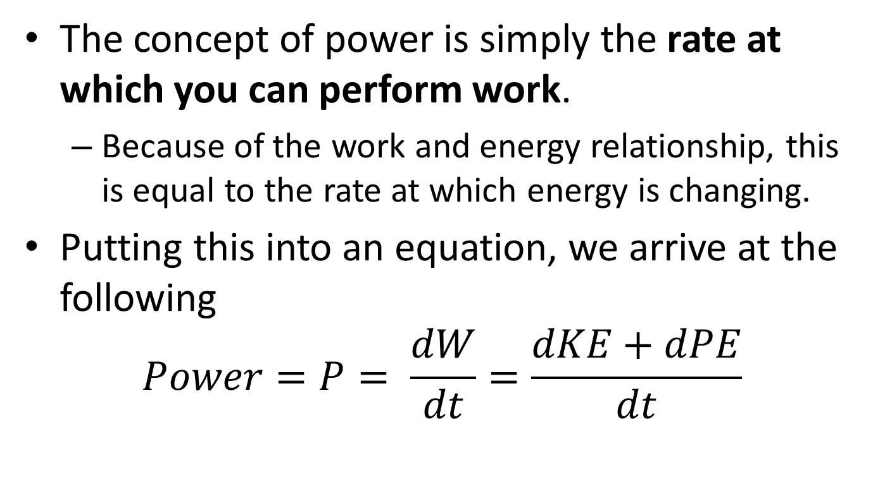
Power
The concept of power is simply the rate at which you can perform work.
Because of the work and energy relationship, this is equal to the rate at which energy is changing.
Putting this into an equation, we arrive at the following
$$Power=P= \frac{dW}{dt}=\frac{dKE+dPE}{dt}$$

Slide 3
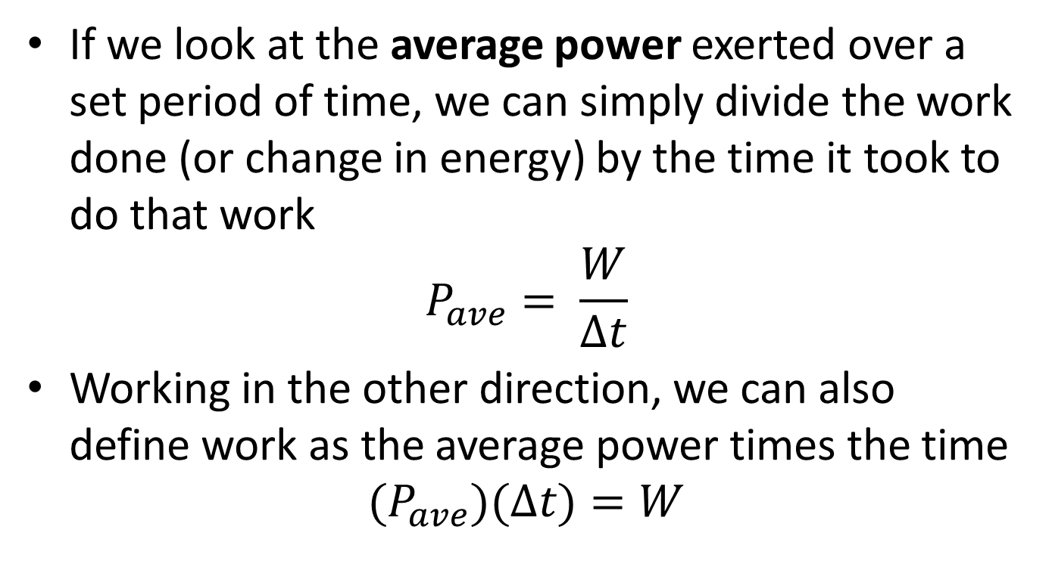
Power
If we look at the average power exerted over a set period of time, we can simply divide the work done (or change in energy) by the time it took to do that work
$$P_{ave}= \frac{W}{∆t}$$
Working in the other direction, we can also define work as the average power times the time
$$(P_{ave})(∆t)=W$$

Slide 4
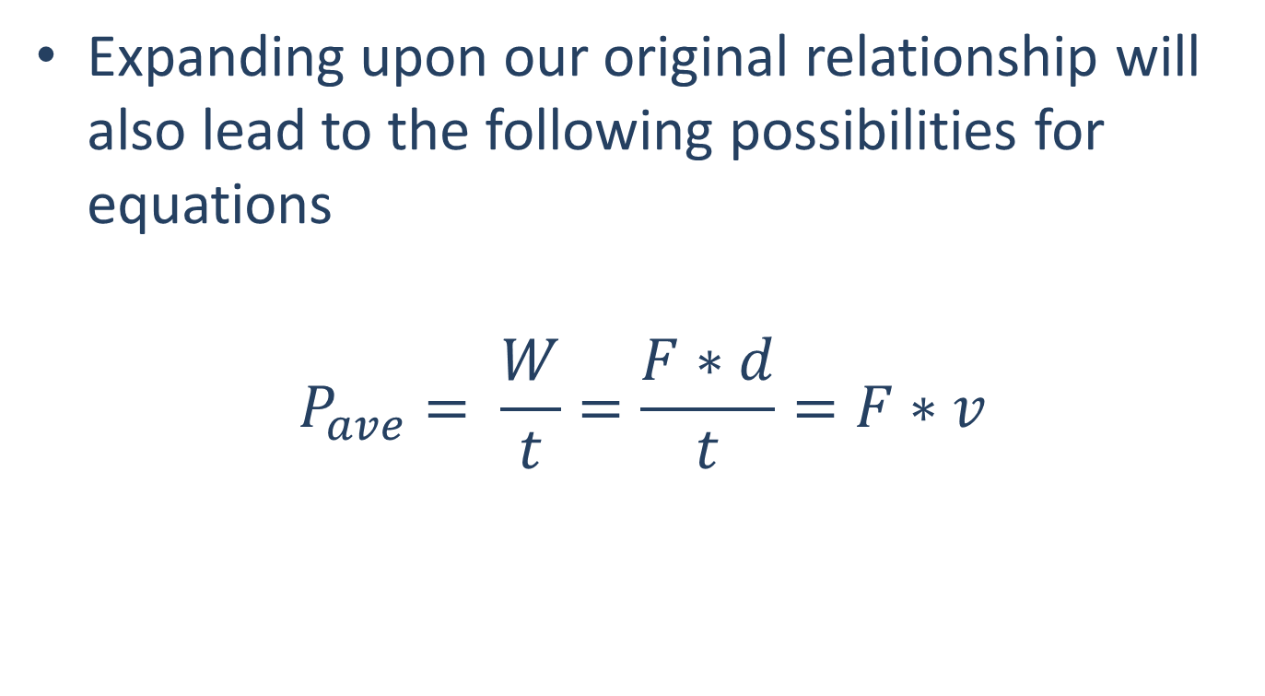
Power in Translational Systems
Expanding upon our original relationship will also lead to the following possibilities for equations
$$P_{ave}= \frac{W}{t}=\frac{F∗d}{t}=F∗v$$

Slide 5
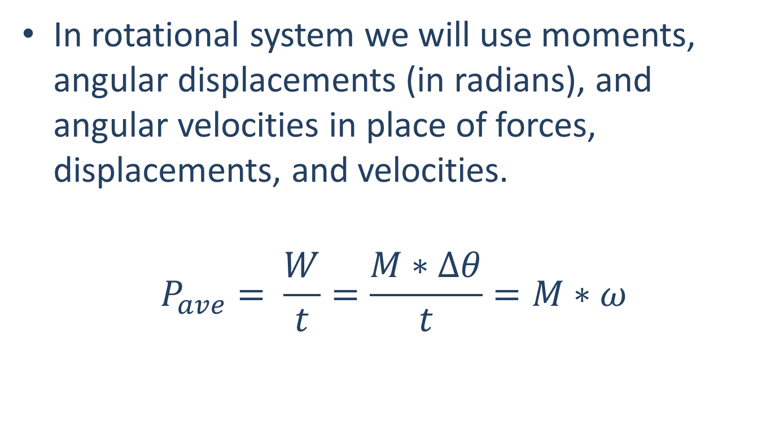
Power in Rotational Systems
In rotational system we will use moments, angular displacements (in radians), and angular velocities in place of forces, displacements, and velocities.
$$P_{ave}= \frac{W}{t}=\frac{M∗∆θ}{t}=M∗ω$$

Slide 6
Power Units
The units of power generally are a unit force times a unit distance per unit time.
In the metric system...
$$Watt=W=1\frac{J}{s}=1\frac{Nm}{s}$$
In the English system...
$$Horsepower=hp=550\frac{ft lb}{s}$$

Slide 7
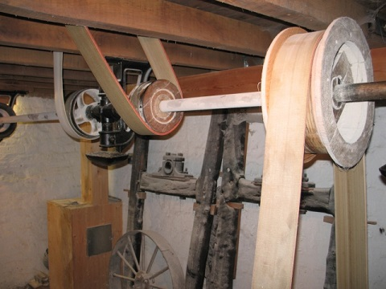
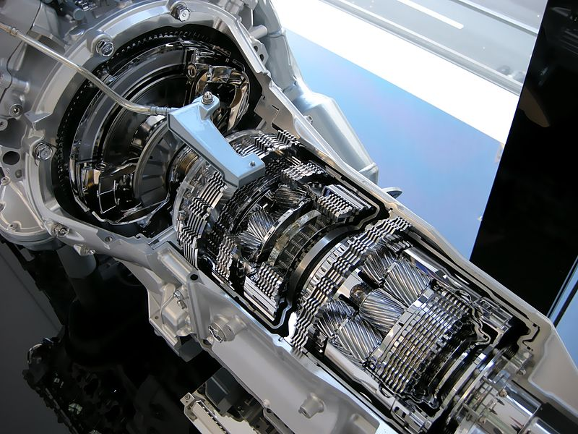
Power Transmission
Engineers will frequently need to transfer work or power from one location to another in a system. A common method for doing this is a combination of shafts, pulleys, and gear trains.
Measuring the angular velocity and torque in a shaft lets us easily identify the power being transferred
While belts and pulleys, along with gear trains will alter the torques and angular velocities, the overall power will remain the same throughout the system, at least ignoring friction losses.
Image by Ian Petticrew CC-BY-SA 2.0
Public Domain Image by Hatsukari715

Slide 8
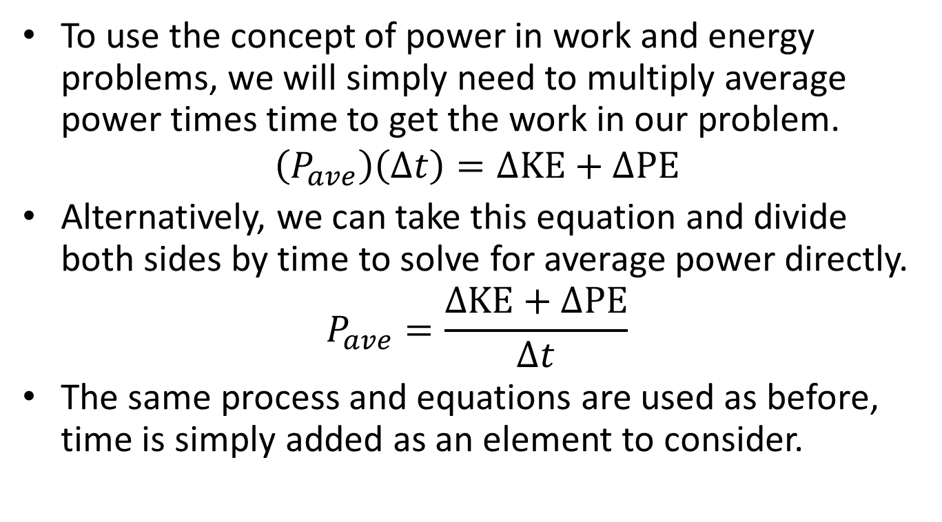
Using Power in Work and Energy Problems
To use the concept of power in work and energy problems, we will simply need to multiply average power times time to get the work in our problem.
$$\left(P_{ave}\right)\left(∆t\right)=∆KE+∆PE$$
Alternatively, we can take this equation and divide both sides by time to solve for average power directly.
$$P_{ave}=\frac{∆KE+∆PE}{∆t}$$
The same process and equations are used as before, time is simply added as an element to consider.

Slide 9
Thanks for Watching
See other engineering mechanics videos and access the full tool at…

Slide 10
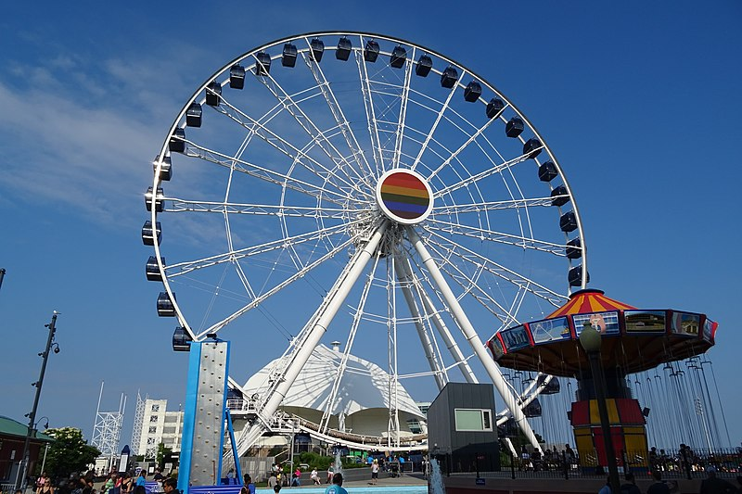
Worked Example
The Ferris Wheel shown below can be approximated as a thin circular ring with a diameter of 96 meters and a mass of 20,000 kg. What is the power required from a motor in order to bring the Ferris wheel from rest to its operating speed of 0.5 rotations per minute over the course of 15 seconds?
Image by Orlandowood365
CC-BY-SA 4.0

Slide 11

Worked Example
A small off-road trailer can be approximated as a rectangular prism with a mass of 100kg supported by two wheels each approximated as thin circular discs with as mass of 25 kg and a diameter of 60 cm. Assuming the wheels roll without slipping, what is the power required to bring the trailer from rest to a speed of 80 kph over the course of 10 seconds?

Slide 12
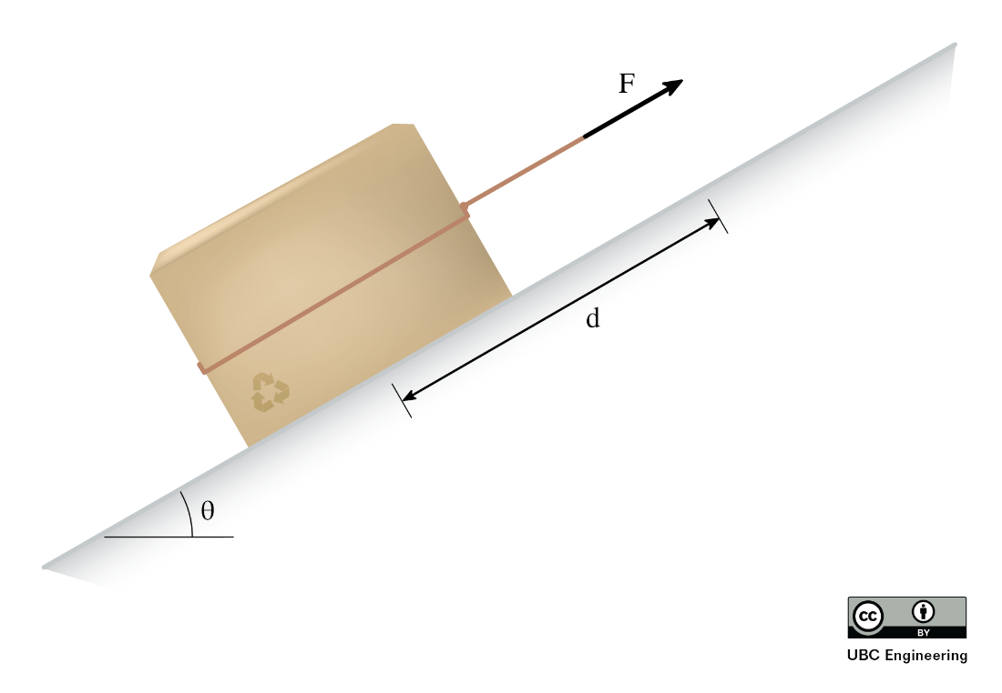
Worked Example
You ask your little cousin to move a 1 kg box up a hill with a coefficient of kinetic friction μ_{k}=0.2. Rather than carrying the box, he overthinks things and drags the box up the hill with a rope. Determine the average power exerted by your little cousin if he applies a force F=10 N and he drags the box up the hill d=3 m with an incline of θ=30 degrees.

